Slide 1
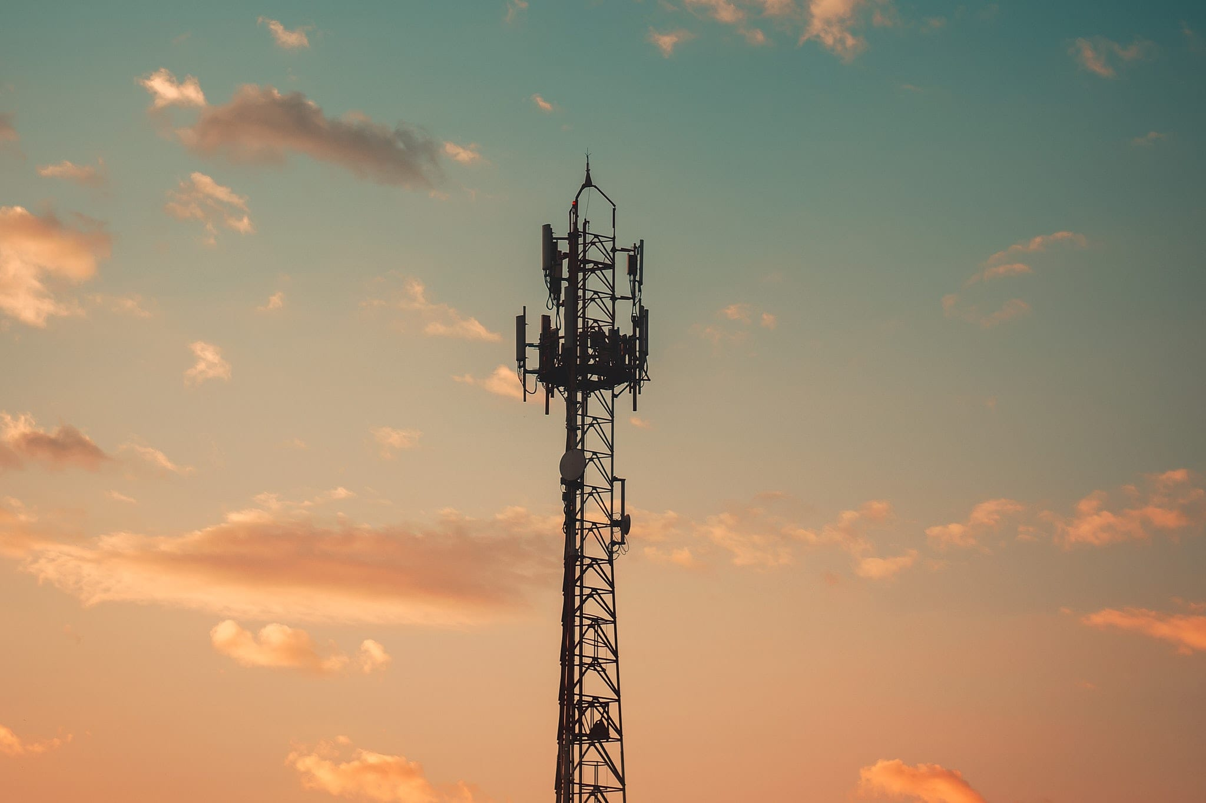
FCC REVIEWS AT THE ARIZONA SHPO
JANUARY 30, 2023

Slide 2
WHY WE ARE HERE:
Clarify Arizona’s review process
Provide updates to our review process
Address some ongoing problems with submissions
Discuss Tribal partners’ concerns
Notes:
Note that the information provided to you is, in part based on SHPO’s engagement with Tribes as well as the FCC.

Slide 3
REGULATIONS
Section 106 of the National Historic Preservation Act (36 CFR Part 800)
Nationwide Programmatic Agreement for Review of Effects on Historic Properties for Certain Undertakings approved by the FCC (2004)
Nationwide Programmatic Agreement for the Collocation of Wireless Antennas (2005)
Notes:
See ACHP and FCC Websites

Slide 4
REGULATIONS
State and Local Ordinances (where applicable)
Arizona Antiquities Act (41-841 et seq.)
City of Phoenix, City of Tucson, etc.

Slide 5
QUALIFICATIONS
Section 106:
Secretary of the Interior Professional Qualifications
State, County, and Municipal land:
Arizona Antiquities Act (AAA) permit
Notes:
See ASM CRM website

Slide 6
RESOURCES
Survey Report Standards (2016)
Interim SHPO-ASM Reporting Guidance (2019)
FCC Guidance Update (July 2018)
Verizon HPTP for Private Lands (2018)
SRSF Template (2018)
New Consultation Form (Jan 2023)
ASM Site Definitions (1995)
Notes:
See SHPO website

Slide 7
HISTORIC PROPERTIES
All prehistoric and historical archaeological sites, districts, buildings, structures or objects that are listed or eligible for listing in the National Register of Historic Places
AZ SHPO TREATS ALL
UNEVALUTED SITES AS ELIGIBLE
FOR
FCC UNDERTAKINGS
* AZ SHPO recently determined Huhugam canals in the Phoenix Basin eligible under Criterion D
Notes:
*Make sure to check the canal layer in AZSITE

Slide 8
SUBMISSION PACKETS TO SHPO
Three main parts:
FCC – SHPO Consultation Form (separate pdf)
FCC Form 620 (new towers) or 621 (collocations) (revised 2018)
Results Reports
Class I / Visual Assessment Letter Report
SRSF or Class III Technical Report (separate pdf)
Notes:
The FCC-SHPO consultation must be submitted as a separate pdf.
Class III reports, including the SRSF, must be submitted as a separate pdf.
Class I information can be a letter report or integrated into the FCC 620/621 form; all results and photographs must be included.

Slide 9
FORM 620 VS. 621
Form 620
Form 621
New Construction
Replacement Tower
Collocation
With ground disturbance
Without ground disturbance

Slide 10
FCC – SHPO CONSULTATION FORM
Updated in January 2023
Specific to Arizona
Changes:
Project Description
Locational Information
APEs
Finding of effect
Tribal Expertise Statement

Slide 11
TRIBAL EXPERTISE
We remind the consultant and FCC that the views of Indian tribes are based on expertise and information not available and/or possessed by our staff, but are critical to informing the Section 106 review process. The consultant/FCC remains responsible for consulting with and considering the views of Indian tribes. We request that consultant provide our office with a summary of any views conveyed by Indian tribes that are not in agreement with SHPO’s response, and in so doing SHPO reserves the right to exercise our responsibility to respond to new information and modify our findings, as necessary.
Notes:
If tribes provide information regarding TCPs, inform SHPO so we can continue consultation.

Slide 12
TRIBAL CONSULTATION
Tribal consultation should be completed prior to submittal of any documentation to SHPO.
Please let us know of any concerns that are raised through consultation.
Class III reports should be sent to tribes with the consultation packet
Some things to consider:
Are you in or near a Traditional Cultural Property (TCP)
Is your visual APE large enough to identify TCPs or historic properties?

Slide 13
FCC – SHPO CONSULTATION FORM PROJECT DESCRIPTION
New construction, replacement, collocation
Utility corridors?
Access routes?
Ground disturbance?
Notes:
The project description should include whether there is new or replacement construction or collocation as well as whether it will include utility corridors, access routes, and ground disturbance.
If the pole is a replacement, provide the height of the original pole.

Slide 14
FCC – SHPO CONSULTATION FORM LOCATIONAL INFORMATION
Structure Address
Land Jurisdiction
Legal Location
USGS Quadrangle
UTM Coordinates

Slide 15
FCC – SHPO CONSULTATION FORM DIRECT APE
Acreage
Dimensions
Include utility corridors, access roads, staging areas
Depth of excavation
Notes:
The direct APE should include the total acreage, direct APE dimensions, including utility corridors, access roads, staging areas, and depth of excavation.

Slide 16
FCC – SHPO CONSULTATION FORM VISUAL APE
Radius – 0.5, 0.75, 1, 2 miles
Google Earth view – is there line of site from tower to major topographic feature or archaeological site with standing architecture
Notes:
According to the NPA, the visual APE is:
Towers under 200 ft = 0.5 mile
Towers that are 200-400 ft = 0.75
Towers that are over 400 ft = 1.5 miles
Due to the potential for TCPs or historic properties with standing architecture, we advise adjusting the visual APE for areas with larger viewsheds or areas where topographic features area visible from the tower location.
If this is not done with initial consultation, tribes or SHPO may request a larger visual APE be considered.

Slide 17
FCC – SHPO CONSULTATION FORM FINDING OF EFFECT
Direct APE:
No Historic Properties Affected (NHPA)
No historic properties in the APE
No Adverse Effect (NAE)
Historic properties are present, but will not be affected (e.g. no ground disturbance within an archaeological site or antenna will be collocated on a historic building)
Adverse Effect (AE)
Within a historic property and ground disturbance will occur
* SHPO does not accept “No Effect” as a finding of effect. If sites are present, use NAE.
Notes:
Note that we no longer include Conditional No Adverse Effect (cNAE) on the consultation form.
Please also note that SHPO does not use “No Effect” for historic properties within the direct or visual APE. If historic properties are present, the finding should be No Adverse Effect, if not present, it is No Historic Properties Affected.
If the undertaking will have an Adverse Effect, a Memorandum of Agreement (MOA) must be prepared and consulted on.
The FCC has an MOA template that can be used as a starting point.

Slide 18
FCC – SHPO CONSULTATION FORM CONDITIONAL NO ADVERSE EFFECT (CNAE)
At SHPO’s discretion
Will require monitoring
Uses:
Within a recognized buffer of a historic property
Within 50 ft of projected ancestral canals
No longer applicable within site boundaries
Notes:
cNAE may be recommended by SHPO if the undertaking is within a site buffer, within 50 ft of a projected ancestral canal, or within an archaeological sensitivity zone.
cNAE requires an qualified and experienced monitor to be present during ground disturbance.
cNAE is no longer applicable within site boundaries.

Slide 19
FCC – SHPO CONSULTATION FORM FINDING OF EFFECT
Visual APE:
No Historic Properties Affected (NHPA)
No historic properties in the APE
No Adverse Effect (NAE)
Historic properties are present, but will not be affected
Adverse Effect (AE)
Historic properties are present and will be affected
Notes:
Note that an undertaking may have an adverse effect if it is in the viewshed of a TCP or a historic property with standing architecture.
Although the FCC requires a separate Finding of Effect for the direct and visual APEs, SHPO will only concur with one finding of effect, which is usually the more conservative effect.

Slide 20
FCC FORMS 620/621
Looking for:
Updated (2018) 620/621 forms
Consistency of information
Correct consulting parties
Tribal consultation results (include emails from the Tribes if the response is Other)
Photographs, maps, and plans
QA/QC of documents
Notes:
Re: 2018 Revision to the 620/621 Forms: We have still been receiving forms that were last revised in 2005. One of the major differences is the way Tribal consultation results are relayed. We like the updated forms better.
Consistency: information should match the FCC-SHPO Form, the 620/621, and the reports.
QA/QC all documents.

Slide 21
CONSULTING PARTIES
SHPO
Affiliated Tribes (TCNS System) (Use the G2G Toolkit to verify all affiliated tribes are included)
Local government
Local historical societies
Historic neighborhoods
Public
Notes:
Local Government: Make sure you are consulting with the correct person at the correct local government.
If you are in a historic neighborhood for the direct or visual APE, you should be reaching out to their neighborhood organization.
Public: Make sure you are sending the public comment request to the correct paper for your location. Make sure the public notice is placed in the correct newspaper.
See Arizona’s G2G Toolkit

Slide 22
RESULTS REPORTS
Three Report Types
Class I Report and Visual Analysis
Class III Technical Report
Class III Survey Report Summary Form
Notes:
See SHPO website

Slide 23
BACKGROUND RESEARCH
Site file search should include:
AZSITE/Archaeological Records Office (ARO)
NRHP
Local historic registers
GLO records
Historic maps and aerials
Notes:
Please note that if you use the ARO to conduct a site file search, you will still require AZSITE to acquire the cultural affiliation and site type.

Slide 24
BACKGROUND RESEARCH
Projects
Archaeological Sites Historic Properties
Agency project number
Project name
Author and year
Agency number
Site/property name
Cultural affiliation
Site type
Author and year

Slide 25
SEARCH RADIUS VS APE
Applicants are required to review the results of the site file search for projects and cultural resources within a mile radius of tower location
If the visual APE is 1 or 2 miles, expand your records search accordingly
Notes:
* Note that the only sites and projects within the direct and visual APEs need to be included in the report
** If historic properties with standing architecture are located within the search radius but outside of the visual APE, please include these in the report.
For undertakings in highly urban areas, a reduced APE can be requested.

Slide 26
CLASS I REPORT AND VISUAL ASSESSMENT
Format: Letter report (preferred)
Use if:
Area has been previously surveyed
Area is paved, landscaped or in an area where the ground surface is not visible
** This information can also be submitted as part of the FCC Form 620/621 without the Class I letter report
Notes:
** If the information is included in the FCC Form 620/621, include complete results tables and assessments.

Slide 27
CLASS III TECHNICAL REPORT
Format: Technical Report
Use if:
A pedestrian survey was completed
Survey identified an archaeological site

Slide 28
CLASS III SURVEY REPORT SUMMARY FORM
Format: SRSF
Use if:
A pedestrian survey was completed
No cultural resources were identified
Cultural resources were limited to isolated occurrences
Cultural resources were limited to in-use historic structures or historic buildings and include the Historic In-use Structure Form (HISF) or Historic Property Inventory Form (HPIF)
Notes:
See SHPO website for links to HISFs and HPIFs

Slide 29
COLLOCATIONS BUILDINGS 45+ YEARS OLD
Collocations of antennas on buildings 45+ years old do not require a HPIF.
Collocations on historic-age towers do require a HISF.

Slide 30
MOST COMMON PROBLEMS
Submissions Missing Components
Forms
Report
Photographs
Tribal Responses
Public Notification
Municipality Response
Notes:
Photographs should include:
To and from the tower site
The access and utility routes
To and from Historic Properties with standing architecture
In areas where the topographic feature is visible, photographs may also include:
View of the topographic feature from the tower site
360 degree views of the surrounding areas

Slide 31
MOST COMMON PROBLEMS
Visual Assessments
Photographs are not included
We have heard from the tribes that they want the APE expanded

Slide 32
MOST COMMON PROBLEMS CLASS I/III REPORTS
Incomplete APE (Must have tower, access road, and utility corridors)
The incorrect report is used
Class I and Visual Assessment
Use a letter report
Put in the 620/621 Form
Class III Survey
Negative findings – SRSF only
Archaeological sites – Technical report
Notes:
If the wrong report is submitted, we may request the report be revised in the proper format.

Slide 33
MOST COMMON PROBLEMS REPORTS
Report information is incorrect or incomplete
SRSF must be completed in full (no blanks; use N/A where appropriate)
Demonstrate knowledge of the area in the Environmental Setting and Cultural Context
Include a detailed description of the undertaking and APE (Remember to include access roads, utility corridors, and staging areas)
The wrong finding of effect is recommended
Notes:
In particular, blanks or N/A will not be accepted in the Environmental Setting or Cultural Context.
SHPO recommends pedestrian surveys be completed by firms familiar with Arizona archaeology.
Wrong Finding of Effect
If historic properties are present, the finding should be NAE or AE.
If ground disturbance is planned within a site boundary, the finding should be AE.
If ground disturbance is planned within the buffer of a site, the finding should be AE, but SHPO may allow cNAE (with monitoring)

Slide 34
QUESTIONS?
Notes:
Some feedback during the consultant workshops:
Feedback from Tribal partners:
Consider inviting tribes for field visits to tower locations to better assess the potential for TCPs
Consider resurveying areas if the surveys are over 5 years old because climate change and erosion may have exposed sites
Tribes do not always get responses for their comments (please provide feedback)
SHPO was asked to also provide a presentation to FCC proponents (SHPO will plan to do this within the coming months)
Proponents need to be informed and guided through the process (SHPO relies on consultants to provide proponents with this information and guidance)
Consultants are not always in-tune with what is and is not a TCP
If it looks like a remarkable topographic or ecological feature, it is probably a TCP
Archaeological reports and FCC Forms should be completed or headed by an SOI-qualified archaeologist
Questions from Consultants:
Regarding photograph requirements: Photographs should be taken to and from the tower location, along access roads and utility corridors, and to and from historic properties with standing architecture. In addition, if remarkable topographic features are visible from the tower site, also include photographs of these to assist with the identification of TCPs.

